Slide 1
Web Forms and HTML
Lecture 1

Slide 2
What Is the World Wide Web?
The World Wide Web—The Web.
It’s a network of computers
able to exchange text, graphics, and multimedia information via the Internet.
You can visit Web-connected computers
next door, at a nearby university,
halfway around the world.
Using either a dialup phone line or a much faster broadband (Ethernet, cable, or DSL connection).
One can take full advantage of the resources these computers make available, including:
text,
graphics,
videos,
sounds,
animation.
Think of the Web as the multimedia version of the Internet, and you’ll be right on the mark.

Slide 3
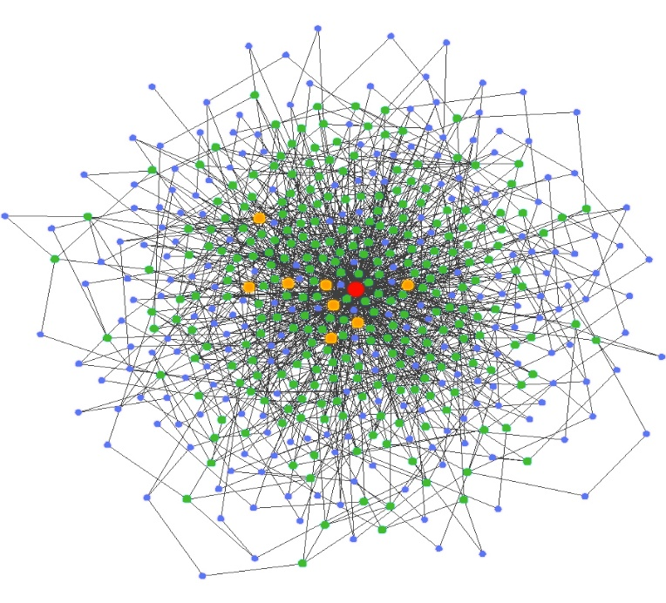
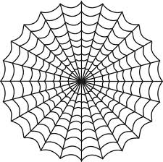

What Is the World Wide Web? (contd.)

Slide 4
What is Hypertext?
The word “hypertext” is a type of text that contains hyperlinks (or just links for short), which enable the reader to jump from one hypertext page to another.
Hypertext gives readers the ability to choose their own path through the material that interests them.
Example:
A book is designed to be read in sequence: Page 2 follows page 1, and so on.
Sure, you can skip around, but books don’t provide much help, beyond including an index.
Computer-based hypertexts let readers jump around all they want.
The computer part is important because it’s hard to build a hypertext system out of physical media, such as index cards or pieces of paper.
The Web is a giant computer-based hypermedia system, and you’ve probably already done lots of jumping around from one page to another on the Web—it’s called “Surfing”.

Slide 5
Hypertext Markup Language(Html)
Markup language uses tags to identify content. It does not perform functions as in scripting languages.
HTML is a language for describing how pages of text, graphics, and other information are organized and linked together.
Or
HTML enables you to mark up text so that it can function as hypertext on the Web.
HTML and HTTP were both invented by Tim Berners-Lee.
The basic structure of an HTML document includes tags, which surround content and apply meaning to it.
The html consist of Elements tags, attributes and values .

Slide 6
Elements And Tags
An element is a construct(made by combination) consisting (usually) of :
An opening tag,
some optional attributes and their respective values,
some content,
a closing tag.
Elements can contain any number of further elements, which are, in turn, made up of
tags,
attributes,
values,
content.
The opening tag can contain multiple attributes, but it cannot contain other elements or tags, while the closing tag cannot contain anything but itself.

Slide 7
Elements And Tags (contd.)
Attribute
Tag
  <a href = “abc.html” > My content </a>
Value
Content
Angle Brackets

Slide 8
Elements And Tags (contd.)
Not all elements have closing tags.
The above said elements are called as self-closing elements, empty elements, or replaced elements – where as the elements with ending and closing tags are called as paired, container tags.
For example: <br>, and <hr>.
A self-closing element requires a space and a trailing slash,
such as <br /> or <hr />.
Attributes
Attributes appear within tags, and they can only contain the value of the attribute.
They can have multiple values separated by space.

Slide 9
HTML V/S XHTML
XHTML stands for EXtensible HyperText Markup Language.
XHTML is almost identical to HTML 4.01 and is a stricter and cleaner version of HTML.
There are several rules that apply to XHTML that do not apply to HTML.
  The <html>, <head>, and <body> tags are all required in XHTML.
  The <html> tag must have an xmlns attribute with a value of http://www.w3.org/1999/xhtml.
  All elements must be closed - opening tag must have either an equal closing tag (if it’s a container tag) or a self-closing space-plus-slash.
  All tags must be written in lowercase.
  All attribute values must be quoted with either single quotes or double quotes.
  All attributes must have values.

Slide 10
Basic Html Page Structure
All HTML documents have three, document-level tags in common. These tags,
<html>
<head>
<body>
delimit certain sections of the HTML document.
<html>
<head>
<title>Basic Page Structure</title>
</head>
<body>
THIS Is my Html Document
</body>
</html>

Slide 11
Html Tags
Head
The <html> tag surrounds the entire HTML document.
This tag tells the client browser where the document begins and ends.
The <head> tag delimits the heading of the HTML document.
or
The <head> element creates a header section for the document.
The heading section of the document contains certain heading information for the document that is not actually content.
The document’s title,
Meta information,
Document scripts are all contained in the <head> section.
Head portion contain invisible stuff that make page work .

Slide 12
Html Tags (contd.)
Body
This is the main body of an HTML document where all of the content is placed.
This is the content that people will see, hear, or otherwise experience when they visit the web page.

Slide 13
Html Tags (contd.)
Title
You should specify a title for every page that you write inside the <title> element. This element is a child of the <head> element). It is used in several ways:
It displays at the very top of a browser window.
It is used as the default name for a bookmark in browsers.
Therefore it is important to use a title that really describes the content of your site.
The <title> element should contain only the text for the title and it may not contain any other elements.

Slide 14
Html Tags (contd.)
Meta
Metadata is data (information) about data,
that will not be displayed on the page
Can be used by the various processes such as, Web Browser and Webserver.
Helps in Search Engine Optimization(SEO).
HTML lets authors specify meta data -- information about a document rather than document content -- in a variety of ways.

Slide 15
Html Tags (contd.)
Meta (contd.)
Examples
Example 1 - Define keywords for search engines:
<meta name="keywords" content="HTML, CSS, XML, XHTML, JavaScript">
Example 2 - Define a description of your web page:
<meta name="description" content="Free Web tutorials on HTML and CSS">
Example 3 - Define the author of a page:
<meta name="author" content="Hege Refsnes">
Example 4 - Refresh document every 30 seconds:
<meta http-equiv="refresh" content="30">
<meta http-equiv="refresh" content="3; url=http://www.google.com" >
Example 5 – Define Charter Set For Page :
<meta charset="UTF-8">
<meta http-equiv="content-type" content="text/html; charset=UTF-8" >

Slide 16
Generic Attributes
Attributes are used to amplify tags.
What we mean by amplify is that when a web browser interprets a tag, it will also search for set attributes and then display the element (tags+attributes) in its entirety.
Many HTML tags have a unique set of their own attributes.

Slide 17
Generic Attributes (contd.)
Attribute | Options | Function
align | right, left, center | Horizontally aligns tags
valign | top, middle, bottom | Vertically aligns tags within an HTML element.
bgcolor | numeric, hexidecimal, RGB values | Places a background color behind an element
background | URL | Places an background image behind an element
id | User Defined | Names an element for use with Cascading Style Sheets.
class | User Defined | Classifies an element for use with Cascading Style Sheets.
width | Numeric Value | Specifies the width of tables, images, or table cells.
height | Numeric Value | Specifies the height of tables, images, or table cells.
title | User Defined | "Pop-up" title for your elements.

Slide 18
Html Formating Tags
Headings(<h1> to <h6>):
Any documents starts with a heading.
You use different sizes for your headings.
Html has headings raging from 1 to 6.
It is a paired Tag.
Example:
<h1>This is heading 1</h1>
<h2>This is heading 2</h2>
<h3>This is heading 3</h3>
<h4>This is heading 4</h4>
<h5>This is heading 5</h5>
<h6>This is heading 6</h6>

Slide 19
Html Formating Tags (contd.)
Paragraph Tag <p>:
Publishing any kind of written works requires the use of a paragraph.
The <p> tag defines a paragraph. Using this tag places a blank line above and below the text of the paragraph.
It is a paired Tag.
You can use align attribute to align your paragraphs.
Left
Center
Right
Justify
Example:
<p>This is paragraph</p>

Slide 20
Html Formating Tags (contd.)
Line Breaks - The <br /> :
A line break ends the line you are currently on and resumes on the next line.
Placing <br /> within the code is the same as pressing the return key in a word processor.
Example:
Line break Really works<br/>
Horizontal Rules - <hr /> :
Horizontal rules are used to visually break up sections of a document.
The <hr> tag creates a line from the current position in the document to the right margin and breaks the line accordingly.
Example:
Hidaya Foundation<hr/>
Hidaya Trust

Slide 21
Html Formating Tags (contd.)
Preserve Formatting - <pre> :
Sometimes you want the text to appear in same format as it was typed in – make use of <pre> …</pre> tags.
Example:
<pre>
Hidaya Foundation
Hidaya Trust
Hidaya Institute Of Science And Technology
</pre>
Bold and Italic Text - (<b>..<b/> <i>..</i> ):
If one wants to make the fonts of content bold , italic – can make use of <b> and <i> tags with respective ending tags.
Example:
This <b>Bold</b> and <i>Italicized </i> text.

Slide 22
Comments In Html
A comment is a way for you as the web page developer to control what lines of code are to be ignored by the web browser.
Placing notes and reminders to yourself is a great way to remind yourself what pieces of code are doing what.
Syntax for commenting
<!--
Code Successfully Commented
-->

Slide 23
Assignments
Write 10 to 15 tags with details and example of each of the following.
Make a html webpage using all the tags you are familier with, and written for assignment#1
Make a simple example of XHTML page.

Slide 24
Questions?

